Slide 1


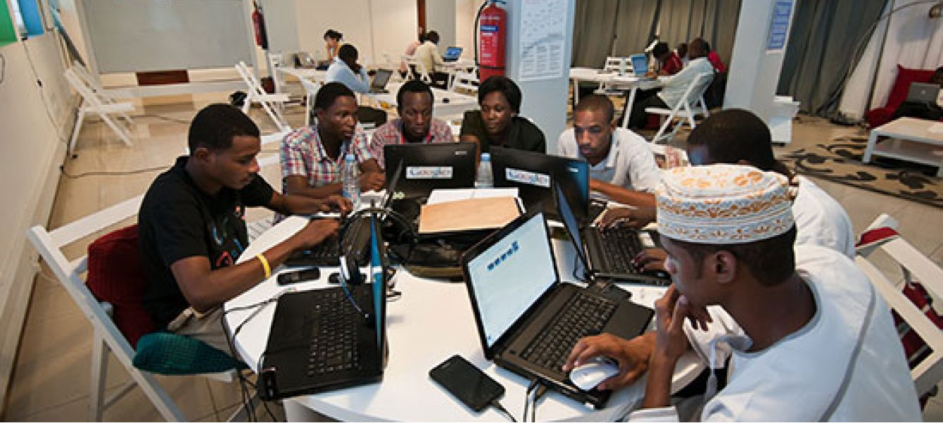

African Languages Project: Igbo <> Yoruba Translation System
This project aims to bridge the communication gap between Igbo and Yoruba speakers by developing a robust, AI-powered translation system. This document outlines the project scope, team structure, technical architecture, community engagement strategy, and initial work breakdown structure. The system will leverage cutting-edge natural language processing (NLP) and machine learning (ML) techniques to provide accurate and contextually relevant translations, fostering greater understanding and collaboration between these two vibrant communities.

Slide 2
Team Roles and Structure
Leadership & Research
Development
DevOps & Linguistics
Josiah Umezurike leads the technical architecture, cybersecurity, infrastructure, and development. Udochi Okeke and Theresa Kennedy focus on full-stack development, research, and project management, with Theresa specializing in AI research.
Olamide Mosobalaje specializes in front-end development using JavaScript. Emmanuel Anaedobe contributes to framework analysis, while Utkarsh Jaiswal provides full-stack development expertise. Olusanya Joy focuses on Python programming, supporting the backend development.
OluwaTobi Oluyole manages DevOps with Python expertise, ensuring smooth deployment and system maintenance. Bolade, our linguist, provides crucial language expertise, guiding the development and ensuring accurate translations.

Slide 3
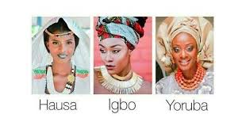
Identified Language Components
1
Core Vocabulary
We will identify and map the core vocabulary shared between Igbo and Yoruba, including common words, phrases, and grammatical structures. This foundation will serve as the basis for accurate translations.
2
Grammatical Structures
Analyzing and comparing the grammatical structures of Igbo and Yoruba is crucial. Understanding the nuances of sentence construction, verb conjugation, and noun declension will improve translation accuracy.
3
Cultural Nuances
We will also identify cultural nuances reflected in language use, ensuring the translation system captures the intended meaning accurately and avoids misinterpretations.

Slide 4

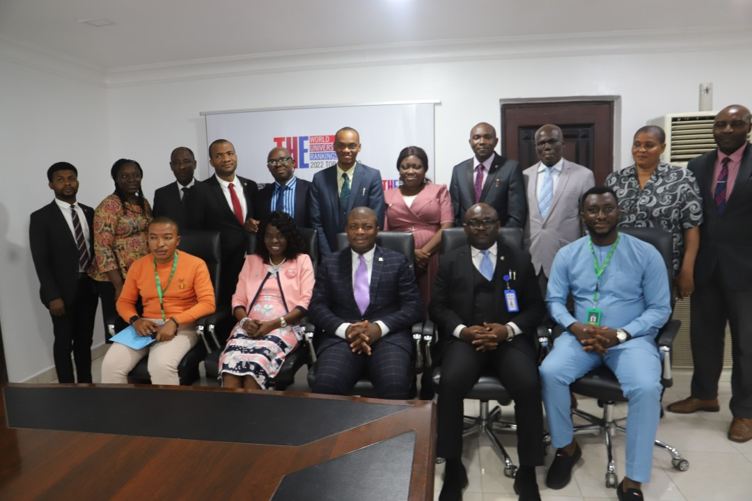



Community Engagement
Awareness Campaigns
We will conduct awareness campaigns to inform communities about the project and its benefits.
Educational Workshops
Workshops will be held to educate users on how to use the translation system effectively.
Feedback Collection
We will actively solicit feedback from the community to improve the system and ensure it meets their needs.

Slide 5
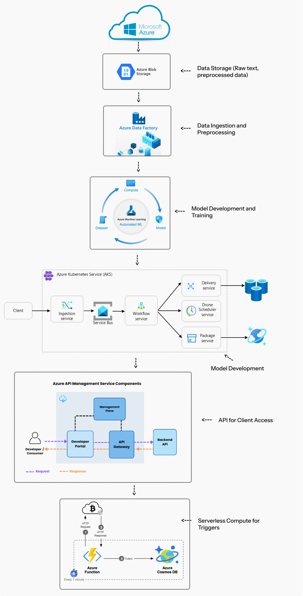



System Architecture
Data Ingestion
Large datasets of Igbo and Yoruba text and audio will be collected and preprocessed.
Model Training
We will train a neural machine translation model using the collected data.
API Development
An API will be developed to allow client access to the translation model.

Slide 6

Technical Requirements
Data Storage
Model Development
Secure and scalable cloud storage solutions will be used to store the language data.
High-performance computing resources are required for model training and development.
API for Client Access
Security
A robust and well-documented API will enable seamless integration with various applications.
Data security and privacy will be prioritized throughout the development process.

Slide 7

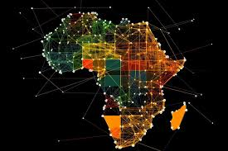
Work Breakdown Structure (WBS)
1
Phase 1: Research and Data Collection
Focus on language analysis, data collection, and team formation.
2
Phase 2: Model Development and Training
Develop and train the core translation model, including initial testing and refinement.
3
Phase 3: API Development and Integration
Develop the API and integrate it with client applications, followed by rigorous testing.
4
Phase 4: Deployment and Community Engagement
Deploy the system and begin community outreach, gather feedback, and iterate based on user input.

Slide 8

Task Assignments
Task
Team Member
Data Collection (Igbo)
Udochi Okeke
Data Collection (Yoruba)
Bolade
Model Development
Theresa Kennedy
API Development
Utkarsh Jaiswal
DevOps
OluwaTobi Oluyole

